Slide 1

Rationale
Introduction to Windows Store App Development Using HTML5 and JavaScript
Computer science is a field of study that deals with solving a variety of problems by using computers.
  To solve a given problem by using computers, you need to design an algorithm for it.
Multiple algorithms can be designed to solve a particular problem.
An algorithm that provides the maximum efficiency should be used for solving the problem.
  The efficiency of an algorithm can be improved by using an appropriate data structure.
Data structures help in creating programs that are simple, reusable, and easy to maintain.
This module will enable a learner to select and implement an appropriate data structure and algorithm to solve a given programming problem.

Slide 2
Objectives
  In this session, you will learn to:
  Use additional UI elements
Notes:
2

Slide 3
Using Additional UI Elements
  You may need to dynamically show elements on the UI that do not remain on the interface all the time.
  Some such elements are:
Popup menu
Menu
Message dialog
Tooltip
Notes:
3

Slide 4


Using Popup Menus
  The PopupMenu control:
  Represents a small lightweight menu.
  Allows users to immediately access the controls that are commonly used for the text or other UI elements in an app.
  Is displayed when a user right-clicks or tap and hold, on a UI element.

Slide 5
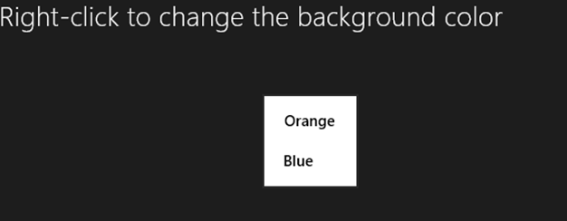
Using Popup Menus (Contd.)
  The following figure shows the popup menu on the UI of an app.
Notes:
5

Slide 6
Using Popup Menus (Contd.)
  To add a popup menu to a control at runtime:
Create the popup menu by creating an object of the Windows.UI.Popups.PopupMenu class.
Add commands to the popup menu by creating instances of the Windows.UI.Popups.UICommand class.
Display the popup menu by using the showAsync() function.

Slide 7
Using Popup Menus (Contd.)
Let us look at an example, which creates a popup menu in an app

Slide 8
Using Tooltips
  The ToolTip control:
  Allows you to add a short description to another control.
  Is displayed automatically when the user hovers the mouse pointer over a control.
  Can contain text or image.
  Can be added to a control by setting its data-win-option property to the WinJS.UI.Tooltip.

Slide 9
Using Tooltips (Contd.)
Let us look at an example, which adds a text tooltip and a tooltip with an image and rich text in an app

Slide 10
Using Menus
  A Menu control is:
  A WinJS control, which is used to display a menu of options.
  Similar to a popup menu in terms of look and feel.
  A lightweight menu that includes commands.

Slide 11
Using Menus (Contd.)
  To create a WinJS menu, you need to perform the following tasks:
Add the menu.
Add menu commands.
Create event handlers.
Associate event handlers.

Slide 12
Using Menus (Contd.)
Let us look at an example, which adds a WinJS menu in an app

Slide 13
Just a Minute
  You can add menu commands to a menu control by adding a button control and setting its data-win-control property to ___________________.
    1. WinJS.UI.Command
    2. WinJS.UI.MenuCmd
    3. WinJS.UI.MenuCommand
    4. WinJS.UI.Menu

Slide 14
Just a Minute (Contd.)
  Solution:
    3. WinJS.UI.MenuCommand

Slide 15
Summary
  In this session, you learned that:
  A popup menu allows users to immediately access the controls that are commonly used for the text or other UI elements in an app.
  The ToolTip control allows you to add a short description of another control.
  A Menu control is a WinJS control that is used to display a menu of options.
Notes:
15

Slide 16

Q&A

